Slide 1

Side Hustles for Developers
Level Up Beyond the 9–5

Slide 2
Do you suffer from any of the symptoms at work?
Feeling trapped in legacy code that hasn’t been cool since 2012?
Confused by how you became an exterminator instead of a developer?
Experiencing chronic boredom from endless Jira tickets?
Suffering from “architectural déjà vu” — building the same app for the 5th time?
Finding that your most innovative idea this week was naming a variable better?
Struggling with vision tunnel syndrome — seeing only backlog, never big picture?
Feeling underappreciated while someone else gets the credit (again)?
Developing a fear of skill rot every time a new framework drops?
Wondering if career progression is just a myth HR made up?

Slide 3
Do you suffer from any of these symptoms at work?

Slide 4

Feeling trapped in legacy code that hasn’t been cool since 2012?

Slide 5

Confused by how you became an exterminator instead of a developer?

Slide 6

Suffering from “architectural déjà vu” — building the same app for the 5th time?

Slide 7

Finding that your most innovative idea this week was naming a variable better?

Slide 8
Suffering from “architectural déjà vu” — building the same app for the 5th time?

Slide 9

Feeling underappreciated while someone else gets the credit (again)?

Slide 10
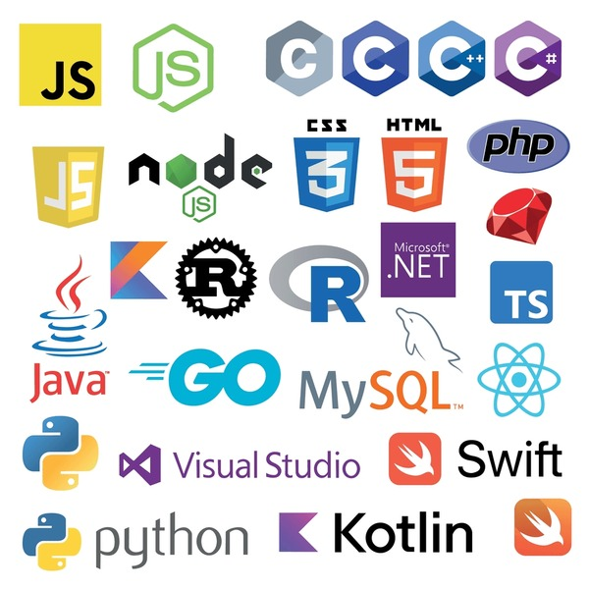
Developing a fear of skill rot every time a new framework drops?

Slide 11
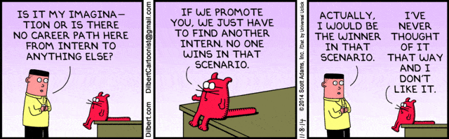
Wondering if career progression is just a myth HR made up?

Slide 12
Then you need a Side Hustle!

Slide 13
What do I mean when I say Side Hustle?
Profit-driven projects – Apps, SaaS, or tools intended to generate income.
Purpose-driven projects – Volunteer work or projects that help a community or cause.
Learning projects – Personal experiments to explore new technologies or frameworks.
Open-source contributions – Participating in or maintaining public projects.
Content creation – Blogs, tutorials, videos, or courses that teach or share knowledge.

Slide 14
Benefits of having a Side Hustle
Skill Expansion – Learn new technologies and frameworks outside of your job’s tech stack.
Creative Freedom – Build what you want, without corporate constraints or client demands.
Career Growth – Stand out professionally with tangible projects and broader experience.
Confidence Boost – Gain self-assurance through independent problem-solving.
Portfolio Building – Create real, demonstrable work you can show to employers or clients.
Networking Opportunities – Connect with other developers, communities, and users through your projects.
Financial Upside – Generate additional income or even replace your main gig.
Purpose & Fulfillment – Work on projects that align with your values.
Resilience & Adaptability – Develop habits of self-direction, experimentation, and persistence.
Renewed Passion – Rekindle your excitement for coding and rediscover why you got into development in the first place.

Slide 15
Benefits of having a Side Hustle

Slide 16

Skill Expansion – Learn new technologies and frameworks outside of your job’s tech stack.

Slide 17

Creative Freedom – Build what you want, without corporate constraints or client demands.

Slide 18

Career Growth – Stand out professionally with tangible projects and broader experience.

Slide 19
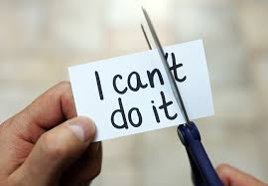
Confidence Boost – Gain self-assurance through independent problem-solving.

Slide 20

Portfolio Building – Create real, demonstrable work you can show to employers or clients.

Slide 21
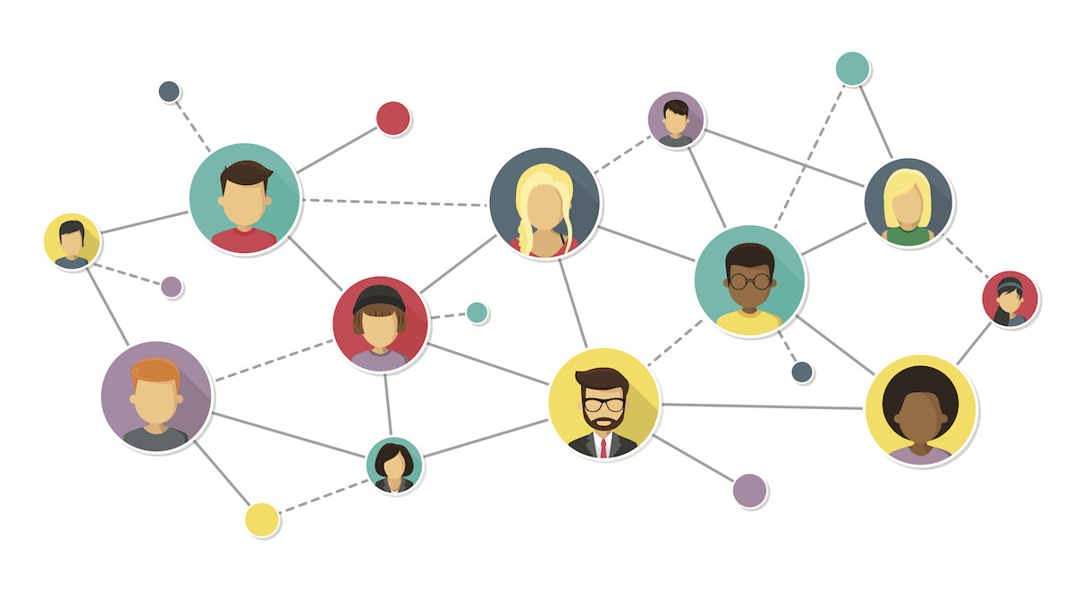
Networking Opportunities – Connect with other developers, communities, and users through your projects.

Slide 22

Financial Upside – Generate additional income or even replace your main gig.

Slide 23

Purpose & Fulfillment – Work on projects that align with your values.

Slide 24

Resilience & Adaptability – Develop habits of self-direction, experimentation, and persistence.

Slide 25

Renewed Passion – Rekindle your excitement for coding and rediscover why you got into development in the first place.

Slide 26
Example side hustles
Notes:
Duane – Church and Lee’s Summit Underwater Rescue and Recovery
Bruce – CSV Reader
Jimmy Bogard– Automapper / MediatR
Rob Renolds – Chocolatey
Richard Cambel – Humanitarian Toolbox
People I know that Talk at conferences,
Jeremy Clark Pluralsight
Me – The Raffler, AI Medical Tool, Finance App

Slide 27
How do I get started?
Choose a project that resonates with you.
Reach out to churches or charities and see what they need.
Offer to help friends or family with a small project.
Look for open-source projects that you use and see if they could use help.
Start a YouTube channel or blog about a topic.
Volunteer at local conferences or community events.
Just get started!

Slide 28
Thank You!
Notes:
Duane – Church and Lee’s Summit Underwater Rescue and Recovery
Bruce – CSV Reader
Jimmy Bogard– Automapper / MediatR
Rob Renolds – Chocolatey
Richard Cambel – Humanitarian Toolbox
People I know that Talk at conferences
Me – AI Medical Tool, Finance App

